Slide 1

Patient Record Management
System
[ Supervised By :- Er. Milan Chikanbanjar ]
Presented by Group :
Prajwol Ghemosu
Sagar Ghemosu
Shekhar Adhikari
Sujan Dumaru

Slide 2
Introduction
Records Management as a discipline involves records keeping.
There cannot be a records management system without records and neither can there be efficient record keeping without a good records management system
Patients Records Management System is a system that aims to keep track of all the patients’ records and be accessed with ease.
Slide <number>

Slide 3
Problem Statement
Lack of immediate retrievals
Lack of immediate information storage
Lack of prompt updating
Error prone manual calculation
Preparation of accurate and prompt reports
Slide 3

Slide 4
Objective
To provide facility of adding, editing, viewing and deleting the information recorded in a file.
Slide <number>

Slide 5
Application
Helps to store patient details.
Immediate access of data/records
Provides medical information about the patients
User friendly Interface
Slide <number>

Slide 6
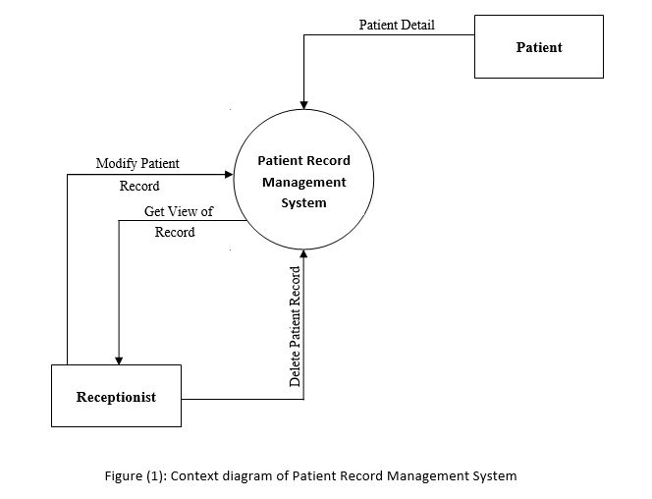
Methodology
Context Diagram
Slide 6

Slide 7
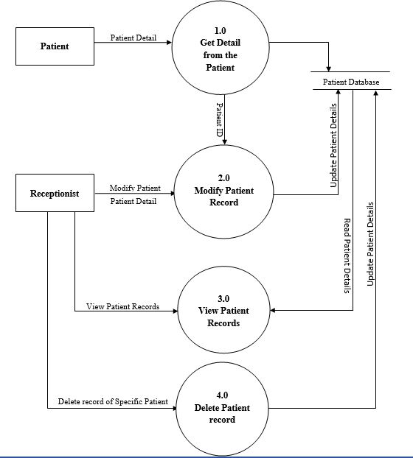
Dataflow Diagram
Slide 7

Slide 8
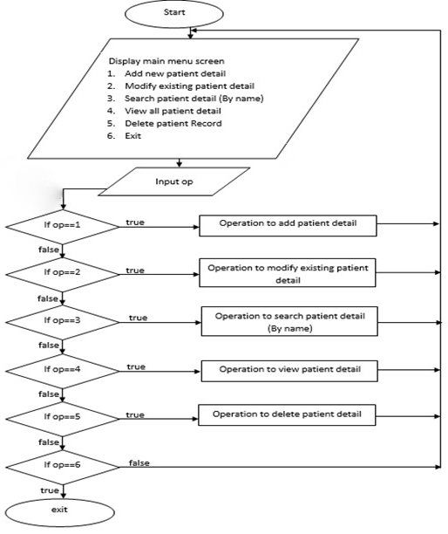
Flowchart
Slide 8

Slide 9
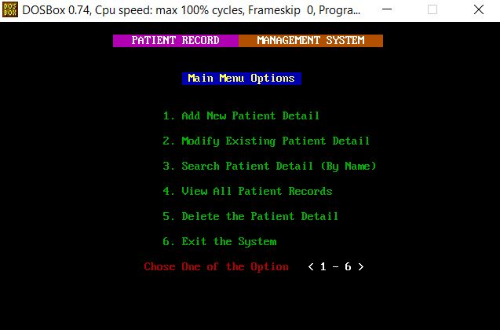
Results
a) Displaying main menu screen
Slide 9

Slide 10
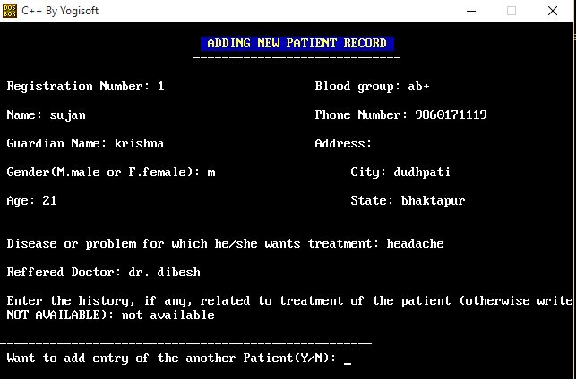
b) Adding new patient details
Slide 10

Slide 11
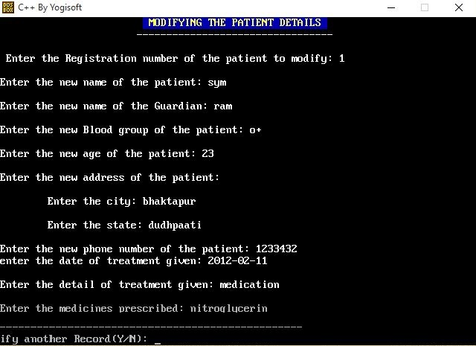
c) Modifying existing patient details
Slide 11

Slide 12
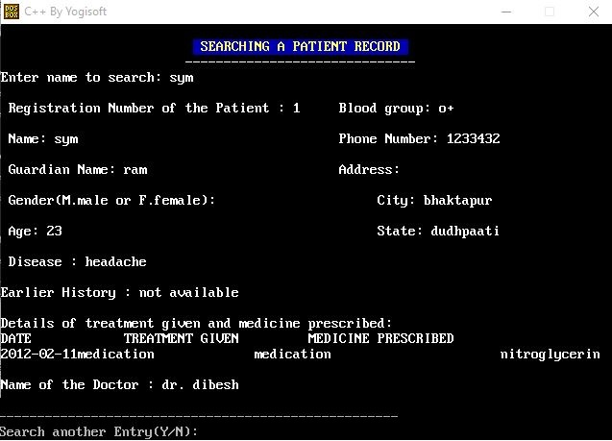
d) Search patient details (By Name)
Slide 12

Slide 13
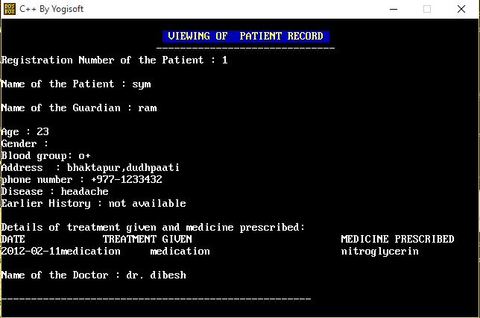
e) View all patient details
Slide 13

Slide 14
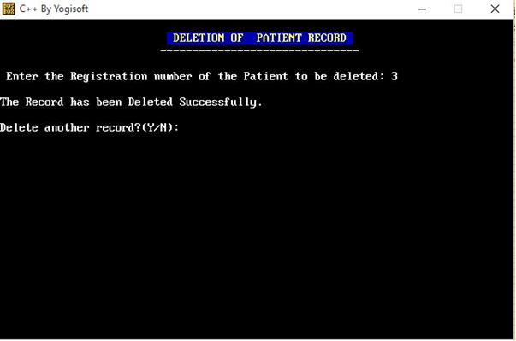
f) Delete patient details
Slide 14

Slide 15
CONCLUSION
We are able to develop patient record management system.
Slide 15

Slide 16
Future Recommendation
Login Security
Add patient billing system.
Improving graphics
Slide 16

Slide 17
THANK YOU
Slide 17

